Slide 1
Paediatric Nephrology

Slide 2
Teaching website
http://paedstudent.cardiff.ac.uk

Slide 5
UTI – cumulative incidence
 | Boys | Girls
By 2 years | 2.2% | 2.1%
By 7 years | 2.8% | 8.2%
By 16 years | 3.6% | 11.3%

Slide 6
When to suspect a UTI
Infants
Pyrexia (>38.5ºC)
Poor feeding
Vomiting
Abdominal discomfort
Febrile seizure

Slide 7
When to suspect a UTI (2)
Older children
Frequency
Dysuria
Wetting
Abdominal pain
Pyrexia

Slide 8
Diagnosis
Collect a urine specimen
MSU
Clean catch specimen
Bag specimen
Catheter specimen
Suprapubic aspirate
Pad specimen

Slide 10
Leucocyte esterase
Identifies presence of white blood cells
High sensitivity for UTI but low specificity

Slide 11
Nitrite test
Reliable sign of infection when positive
BUT high false negative rate
Urine has to have been in the bladder for at least an hour.
This lowers the false negative rate.

Slide 12
Use of both nitrite & leucocyte esterase tests
Has not replaced urine culture in patients suspected
of having a UTI.

Slide 13
What do you do with the urine?

Slide 14
Aims of treatment
Prevention of renal scarring
Achieved through prompt initiation of antibiotic therapy, particularly in those groups at highest risk
Infants
Children with vesicoureteric reflux

Slide 15
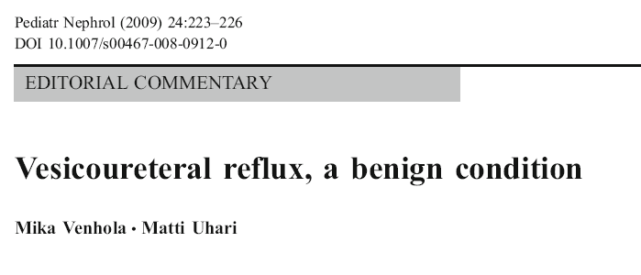
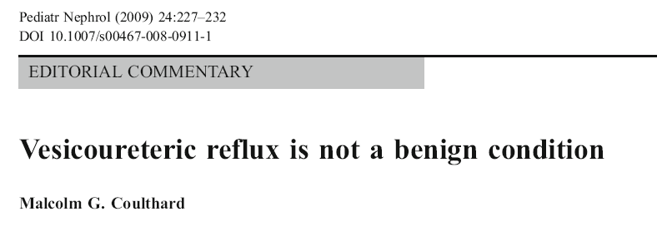

Slide 16
Ultrasound - Normal

Slide 17
Ultrasound - Hydronephrosis

Slide 18
Ultrasound - Scarring

Slide 19
DMSA scan - normal

Slide 20
DMSA - scarring

Slide 21
DMSA - scarring

Slide 22
MCUG - normal

Slide 23
MCUG - normal

Slide 24
MCUG – R sided grade II VUR

Slide 25
MCUG – Bilateral VUR

Slide 26
MCUG – Bilateral VUR

Slide 27
Management of VUR
Antibiotic prophylaxis until 4 -5 years old
Surgery if continue to get UTIs
Reimplantation
Injection of Deflux

Slide 28
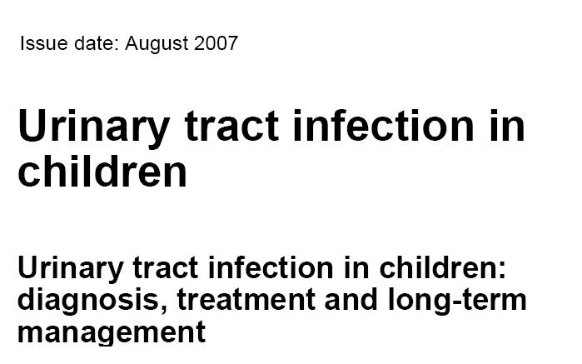

Slide 29
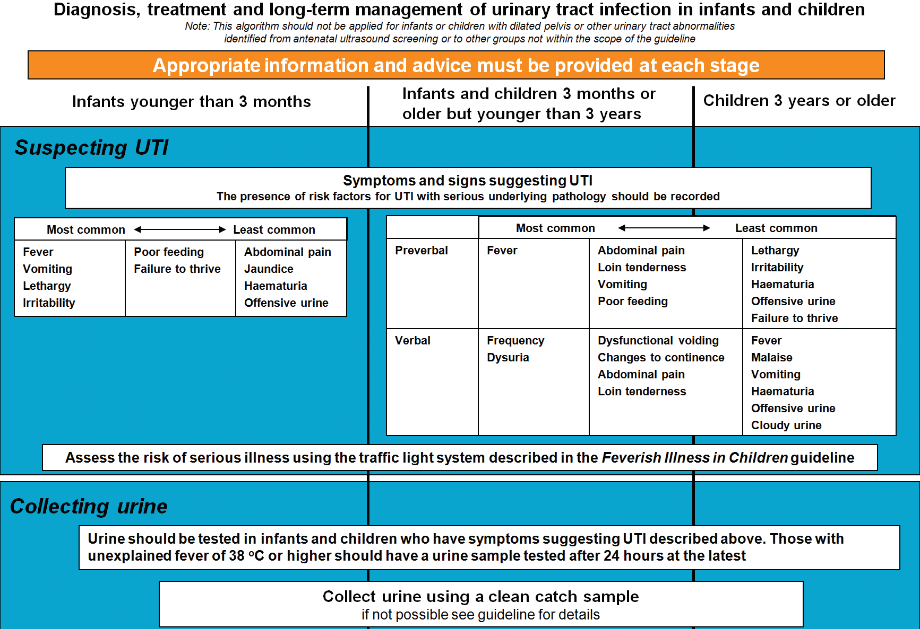

Slide 30
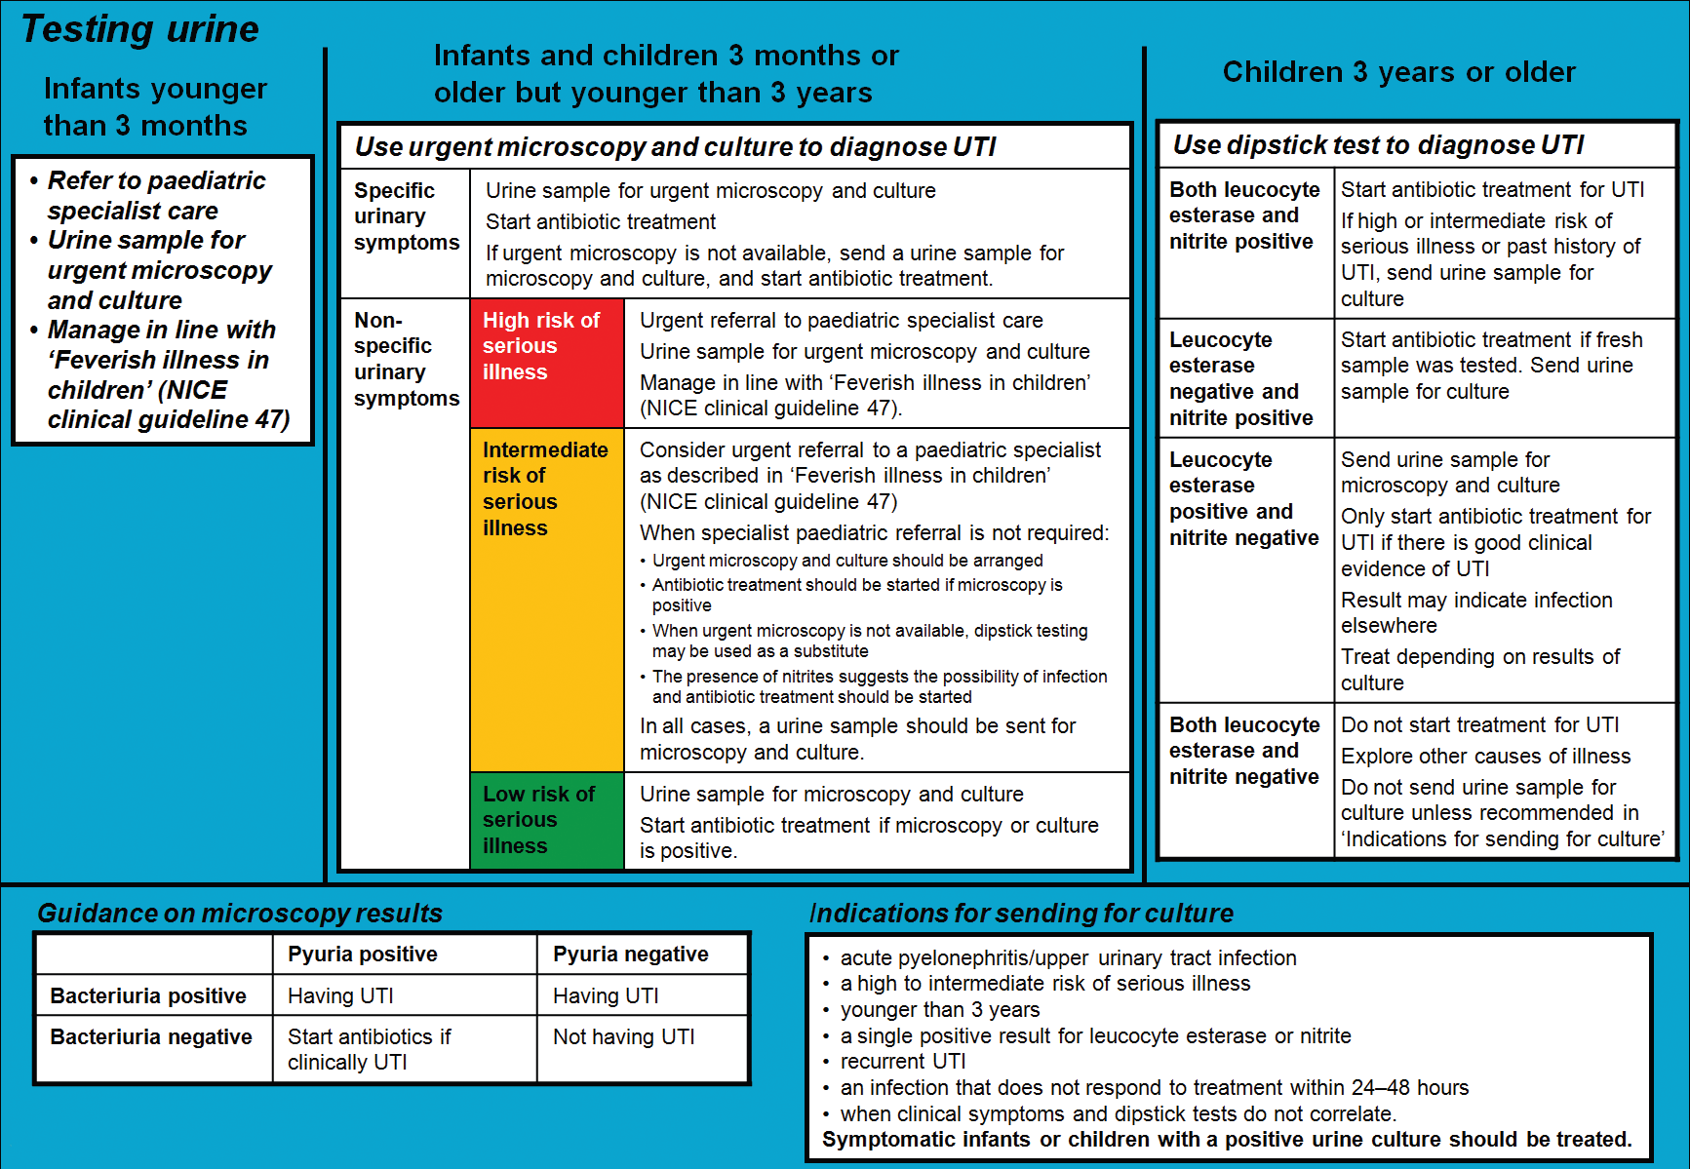

Slide 31
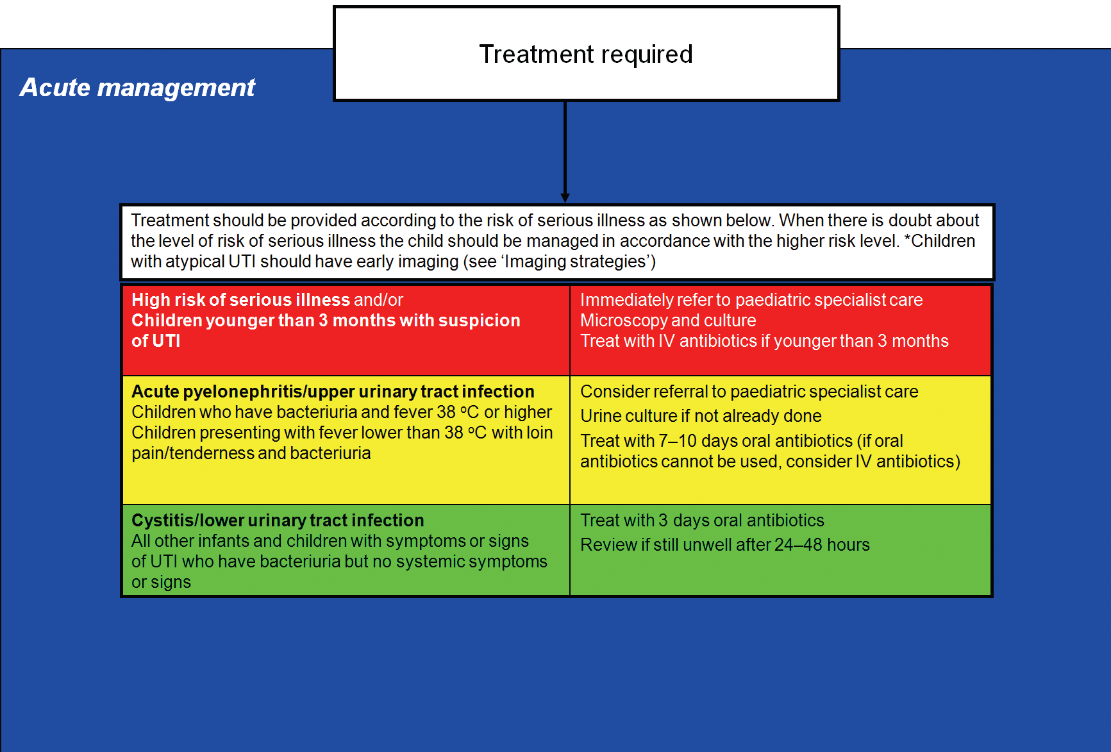

Slide 32
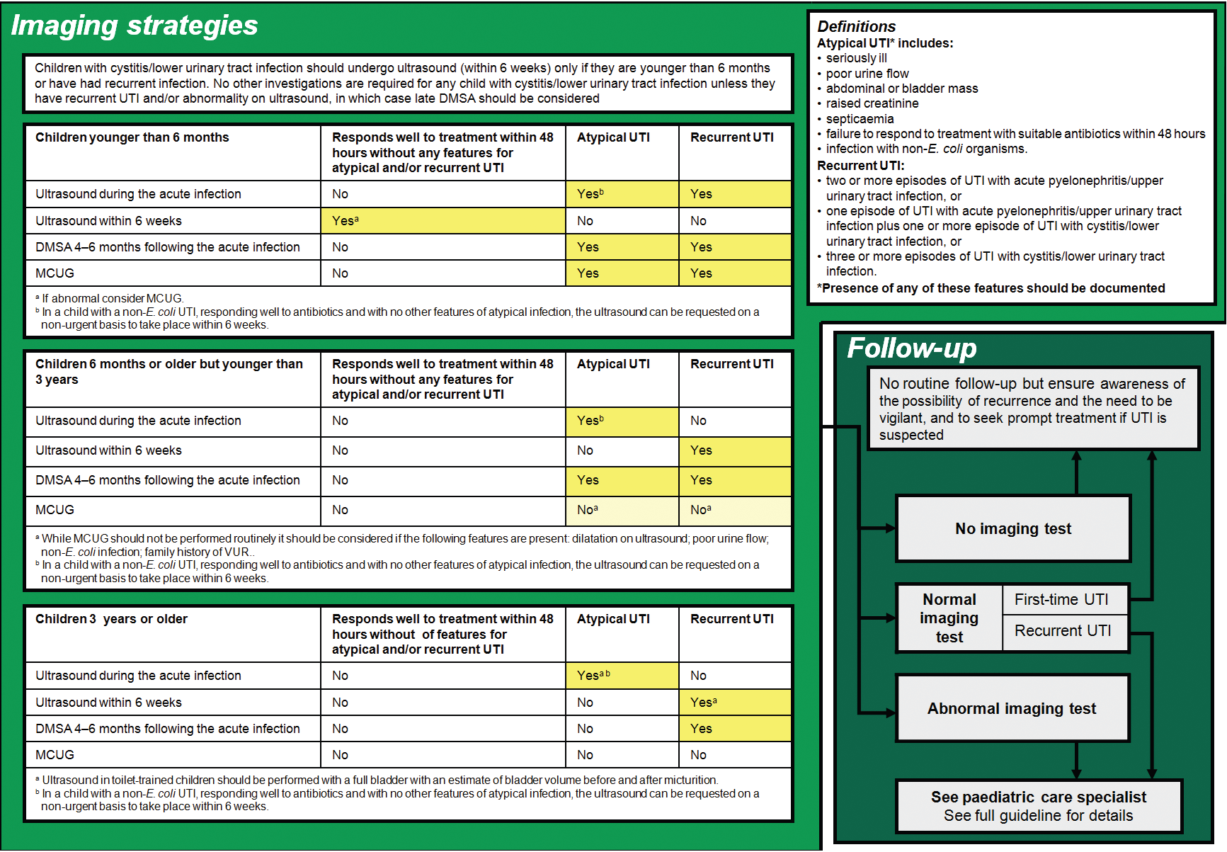

Slide 33
IMPORTANT MESSAGE
Only do an investigation if the result will potentially alter your management of the patient.

Slide 34
Any questions?

Slide 36
Nephrotic syndrome
Triad of:
Heavy proteinuria
Hypoalbuminaemia
Oedema

Slide 39
Normal glomerulus (em)

Slide 40
EM showing foot process fusion

Slide 41
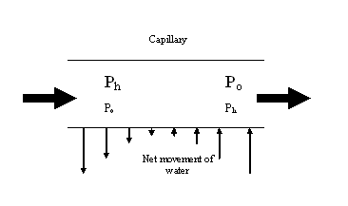
Interstitial fluid
P_{h} - Hydrostatic pressure
P_{o} - Oncotic pressure

Slide 42
Mechanisms of oedema formation (2)
Increased hydrostatic pressure
Hypervolaemia
Increased venous pressure
Reduced oncotic pressure
Hypoalbuminaemia
Increased capillary permeability
Sepsis

Slide 43
Complications
Oedema
Hypovolaemia
Cool peripheries
Prolonged capillary refill time
Abdominal pain
Increased blood pressure
Infection
Hypogammaglobulinaemia

Slide 44
Complications (2)
Hypercoaguable state
Raised haematocrit
Loss of anti-thrombin III

Slide 45
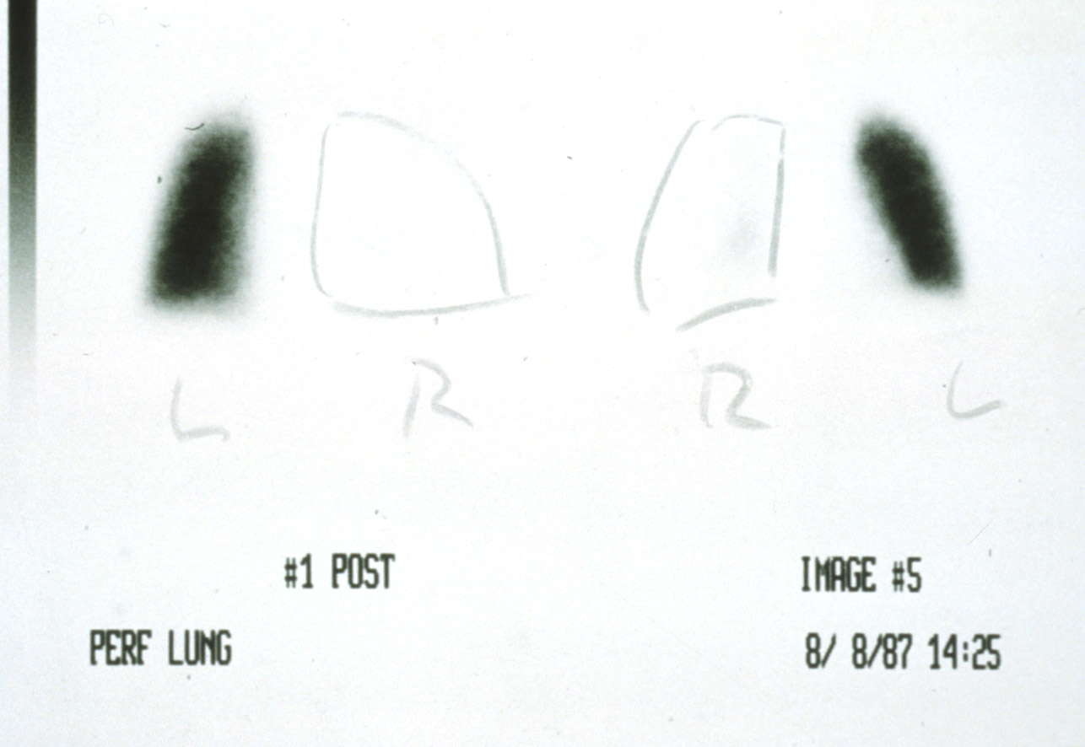
VQ scan in nephrotic patient

Slide 46
Complications (3)
Hyperlipidaemia
Hypothyroidism

Slide 47
Treatment
Lots of steroids

Slide 48
Any questions?

Slide 49
Red cell cast

Slide 50
Tubules filled with red blood cells – source of red cell casts

Slide 52
Dysmorphic red blood cells – Indicates they have had to squeeze through the glomerular basement membrane

Slide 53
Causative organism

Slide 54
Resultant infections
Impetigo
Tonsillitis

Slide 55
Complement

Slide 56
Normal glomerulus

Slide 57
Glomerulus showing a proliferative nephritis

Slide 58
Higher magnification

Slide 59
Immunofluorescent staining for C3

Slide 60
By electron microscopy, the immune deposits of post-infectious glomerulonephritis are predominantly subepithelial, as seen below, with electron dense subepithelial "humps" above the basement membrane and below the epithelial cell. The capillary lumen is filled with a leukocyte demonstrating cytoplasmic granules.
Notes:
By electron microscopy, the immune deposits of post-infectious glomerulonephritis are predominantly subepithelial, as seen above with electron dense subepithelial "humps" above the basement membrane and below the epithelial cell. The capillary lumen is filled with a leukocyte demonstrating cytoplasmic granules. Another example is shown below illustrating the subepithelial deposits.

Slide 62
Features of acute nephritis
Haematuria
Proteinuria
Oliguria
Hypertension
Oedema
Renal impairment

Slide 63
Assessment of renal function
Glomerular filtration rate (GFR)
mls/min
Number of mls of blood cleared of a freely filtered substance each minute.
Correct for body surface area
– mls/min/1.73m²
Creatinine clearance
GFR ∝ 1 / serum creatinine

Slide 64
Creatinine clearance
Fact
If serum [creatinine] is constant, the rate of production of creatinine must equal its excretion.
If serum [Cr] = 100 µmol/l and
Urine [Cr] = 10 mmol/l and
Urine production = 60 ml/hr
What is the rate of creatinine production?
What is the creatinine clearance?

Slide 65
Creatinine production
Urine [Cr] = 10 mmol/l
Urine production = 60 ml/hr
Creatinine excretion =

Slide 66
Creatinine production
Urine [Cr] = 10 mmol/l
Urine production = 60 ml/hr
Creatinine excretion =
10 x 0.06 = 0.6 mmol/h = 600 µmol/h
= 10 µmol/min

Slide 67
Creatinine clearance
Serum [Cr] = 100 µmol/l
Creatinine excretion = 10 µmol/min
Creatinine clearance =

Slide 68
Creatinine clearance
Serum [Cr] = 100 µmol/l
Creatinine excretion = 10 µmol/min
Creatinine clearance =
10 ÷ 100 = 0.1 l/min = 100 ml/min

Slide 69
Renal impairment
What is the creatinine clearance if the serum [Cr] rises to 200 µmol/l?

Slide 70
Renal impairment
Serum [Cr] = 200 µmol/l
Creatinine excretion =

Slide 71
Renal impairment
Serum [Cr] = 200 µmol/l
Creatinine excretion = 10 µmol/min
Creatinine clearance =

Slide 72
Renal impairment
Serum [Cr] = 200 µmol/l
Creatinine excretion = 10 µmol/min
Creatinine clearance =
10 ÷ 200 = 0.05 l/min = 50 ml/min

